Slide 1




Anime Recommendation System

Slide 2










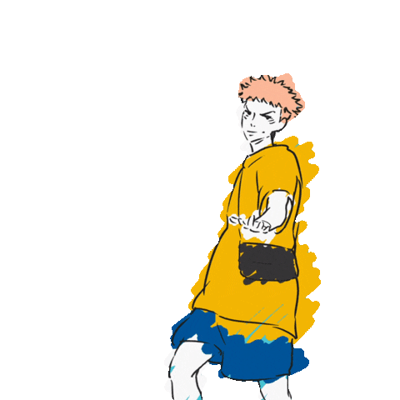
Slide 1
Slide 2
Slide 3
Slide 4
Slide 5
www.AnimeRecommendation.com
Amanjot Singh
Sourav Kumar Singh
Rivi Vig
Amisha Khanna

Slide 3


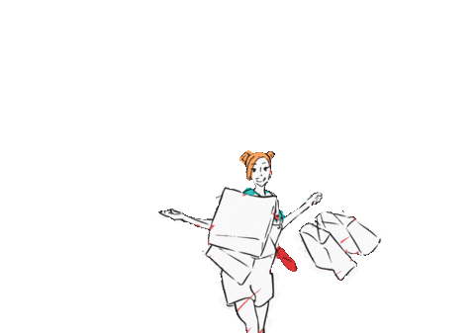
Slide 1
Slide 2
Slide 3
Slide 4
Slide 5
www.AnimeRecommendation.com
Introduction:
Anime is a hand-drawn computer animation originating from Japan which has drawn a cult following around the world. The animation industry consists of more than 430 companies. Dragon Ball Z and Naruto are few of most popular anime shows that have come to Western television.
  This brings us to what we’ve been working on recently:
  A recommendation system that can help anyone or any company to view/add the highest-rated anime.
    In this we will conduct exploratory data analysis to familiarize the reader with the data presented.

Slide 4

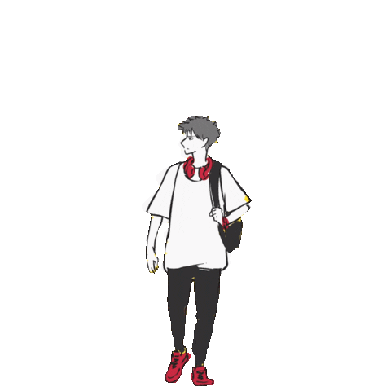
Slide 1
Slide 2
Slide 3
Slide 4
Slide 5
www.AnimeRecommendation.com
OBJECTIVE:
The goal of this project is to recommend and make predictions about a user’s taste. Specifically what a user will want to watch or buy in the future. In order to do such predictions, large amounts of user data is needed to find patterns and associate prior tastes with future choices.
we have downloaded anime and user ratings from https://www.kaggle.com/CooperUnion/anime-recommendations-database .

Slide 5


Slide 1
Slide 2
Slide 3
Slide 4
Slide 5
www.AnimeRecommendation.com
Content Baes Filtering
Single Value Decomposition
Hybrid Recommendation.
Collaborative Filtering
Item collaborative analysis
Exploratory Data Analysis (EDA)
In this we will the analyze the data set to summarize the main data using statistical, graphical and some other data visualization methods.
Analysis
We do a base model, by transforming data.
As we have multiple user ratings, So we Item collaborative filtering analysis, Single Value Decomposition and
Hybrid Recommendation.

Slide 6
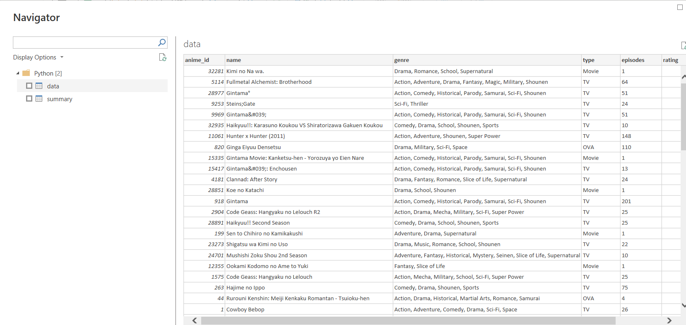
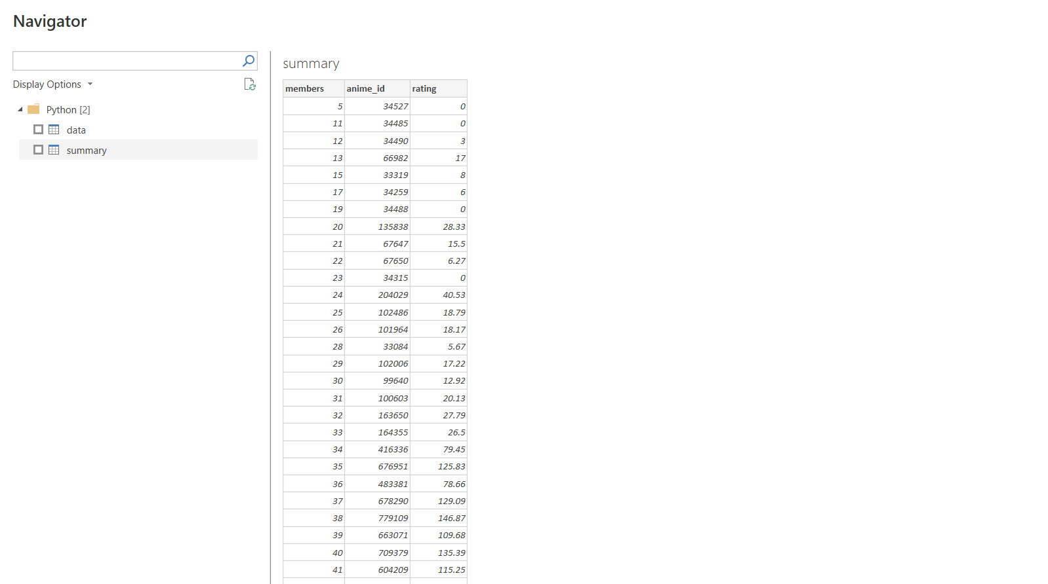
Slide 1
Slide 2
Slide 3
Slide 4
Slide 5
www.AnimeRecommendation.com
Data used for this project:
Anime Data set
Rating Data set

Slide 7
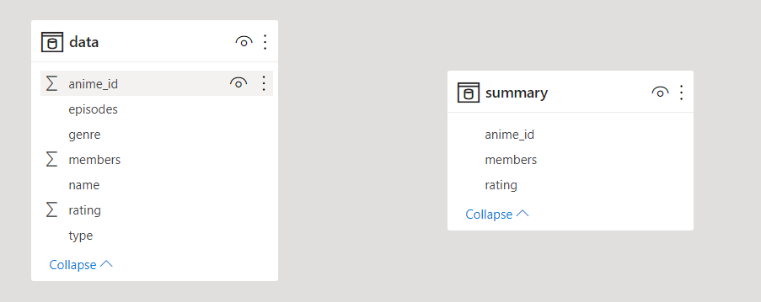
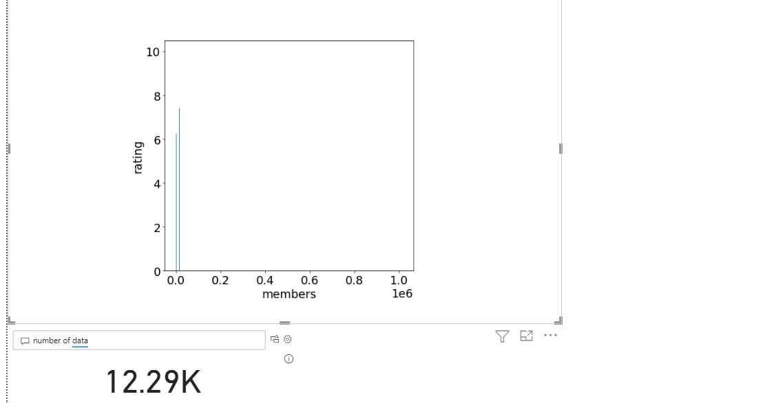
Slide 1
Slide 2
Slide 3
Slide 4
Slide 5
www.AnimeRecommendation.com
Attributes of data:
Number of Data:

Slide 8
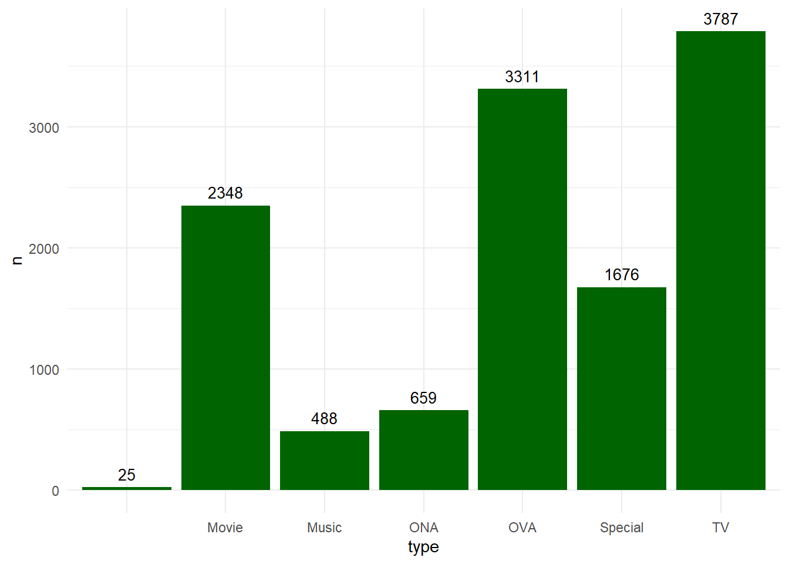
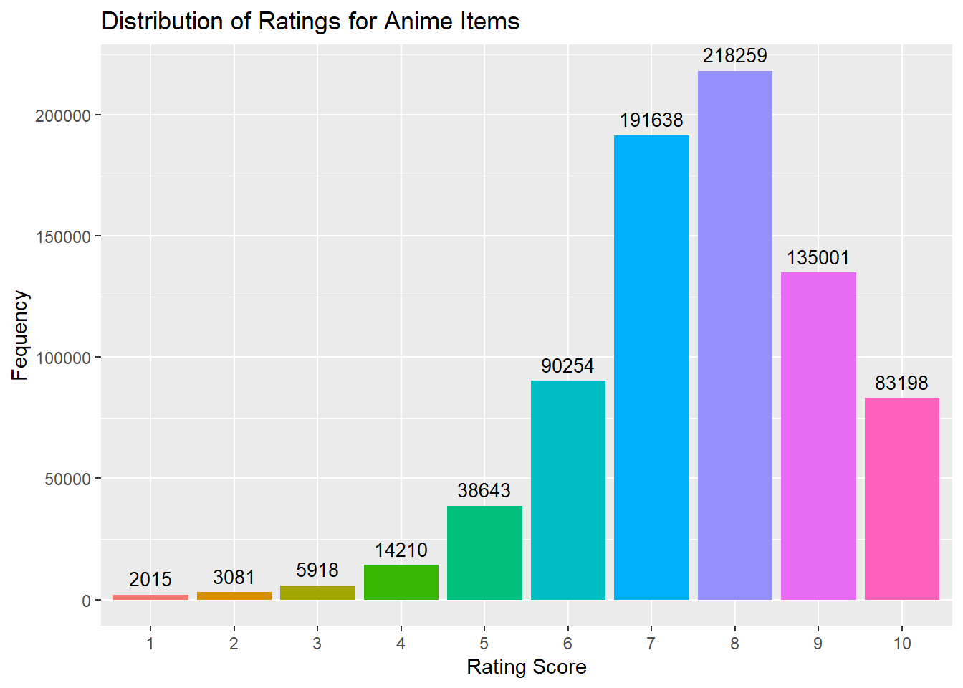
Slide 1
Slide 2
Slide 3
Slide 4
Slide 5
www.AnimeRecommendation.com
Exploratory Data Analysis (EDA):
Most watched type of show:
Ratings distribution:

Slide 9
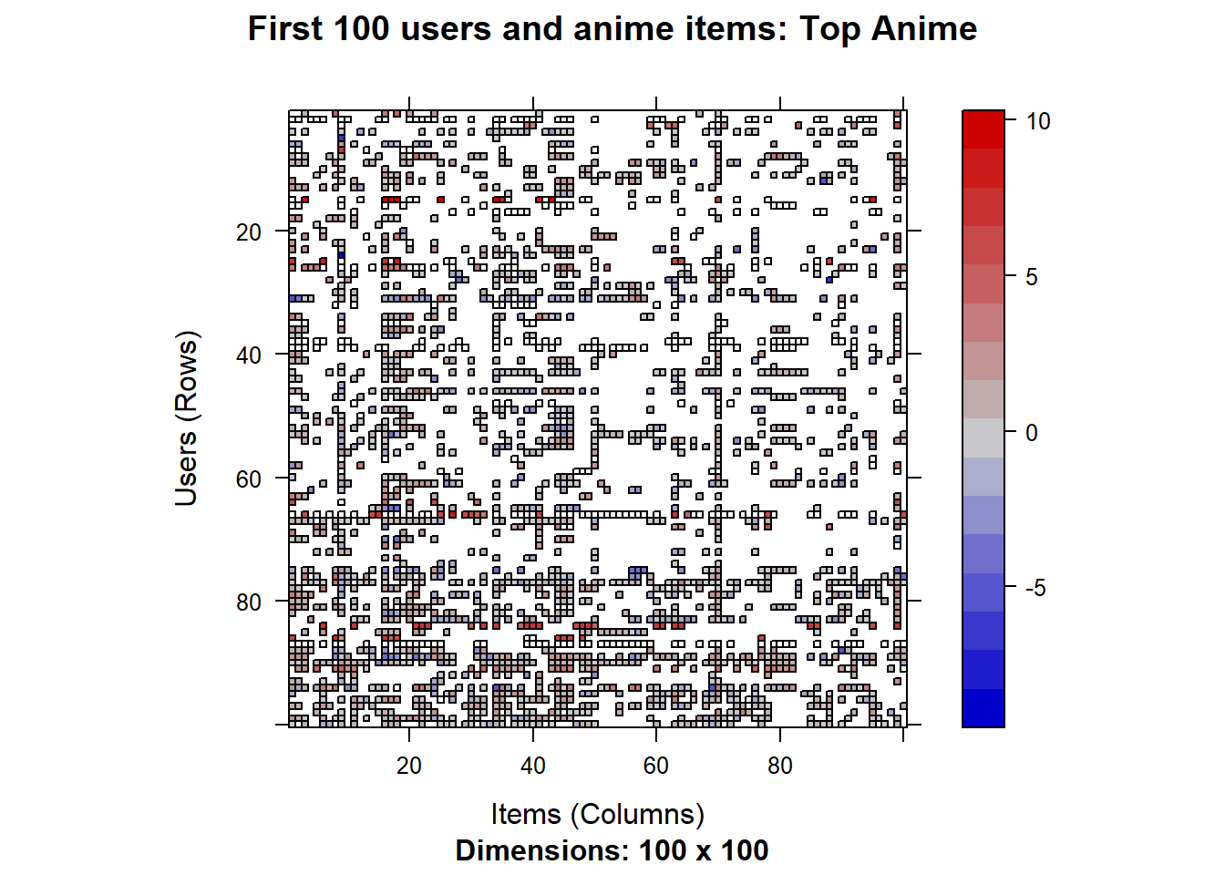
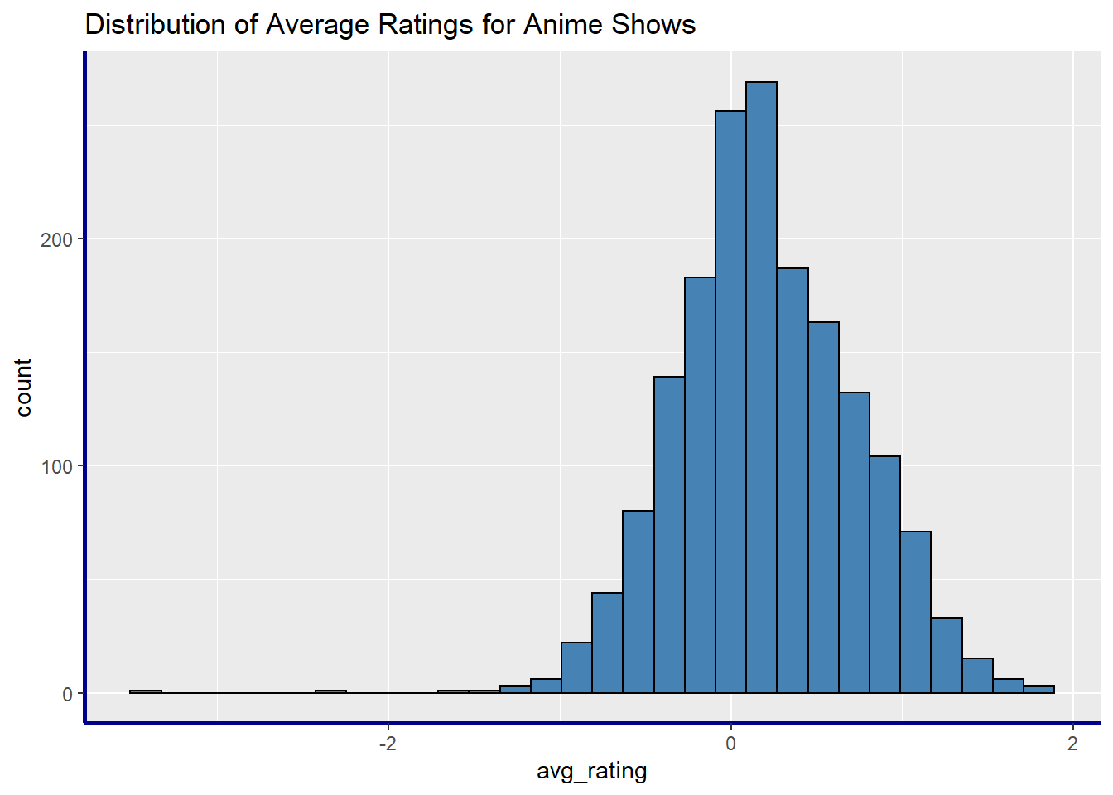
Slide 1
Slide 2
Slide 3
Slide 4
Slide 5
www.AnimeRecommendation.com
Summary of ratings:

Slide 10
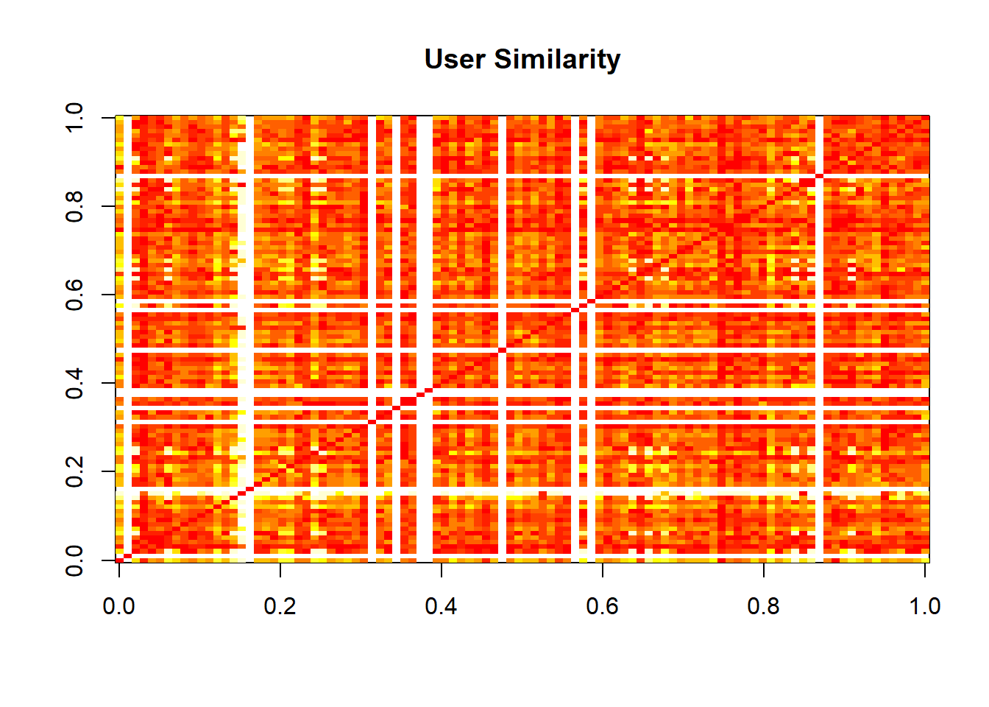
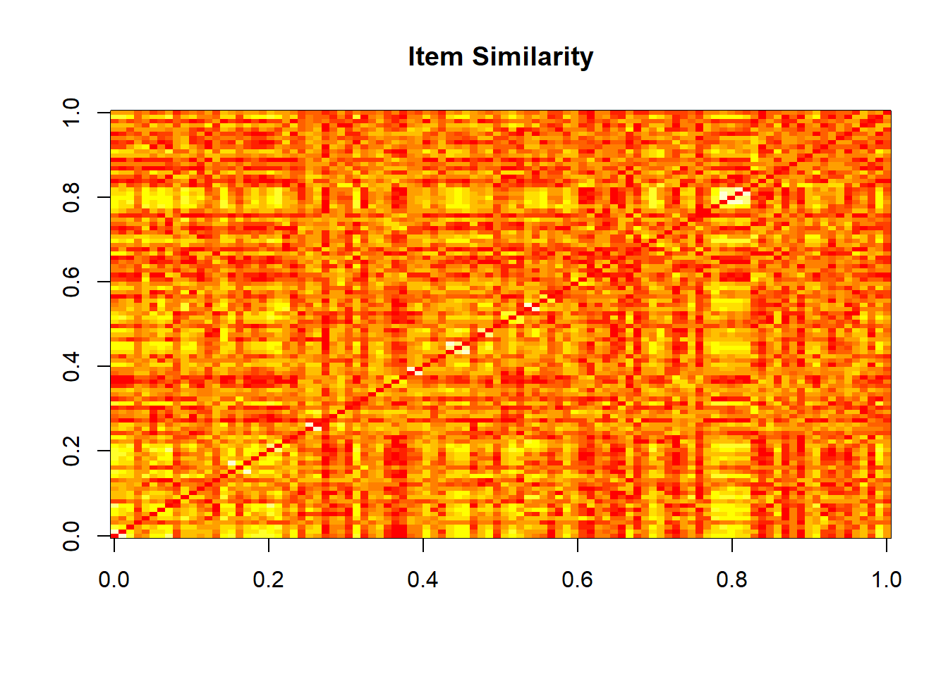
Slide 1
Slide 2
Slide 3
Slide 4
Slide 5
www.AnimeRecommendation.com
Similarity:

Slide 11
Slide 1
Slide 2
Slide 3
Slide 4
Slide 5
www.AnimeRecommendation.com
Building Recommender Systems:
Recommender Systems are systems aims to predict users’ interests and recommend items that are likely to interest them. This helped us to make decisions by discovering new and relevant items. we will look at the way three types of recommenders work.
a) Item based recommender
b) Single Value Decomposition
c) Hybrid Recommender

Slide 12
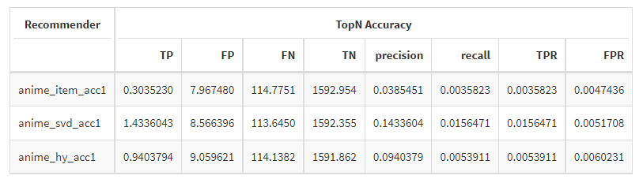
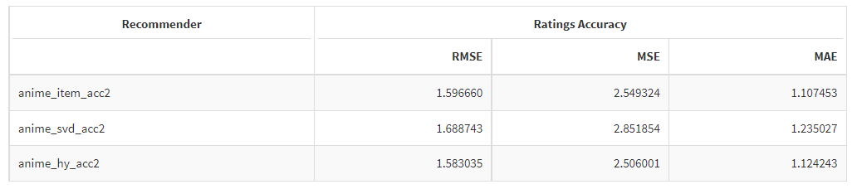
Slide 1
Slide 2
Slide 3
Slide 4
Slide 5
www.AnimeRecommendation.com
Evaluation:

Slide 13
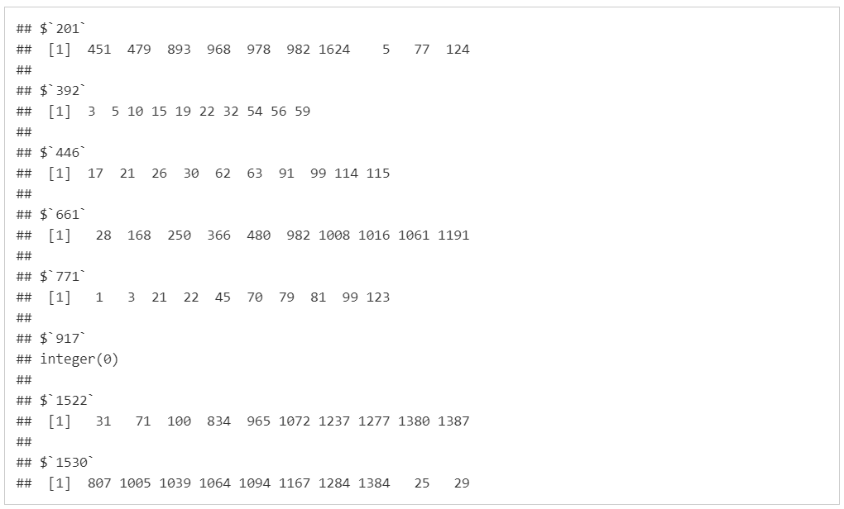
Slide 1
Slide 2
Slide 3
Slide 4
Slide 5
www.AnimeRecommendation.com
Item based recommender:

Slide 14
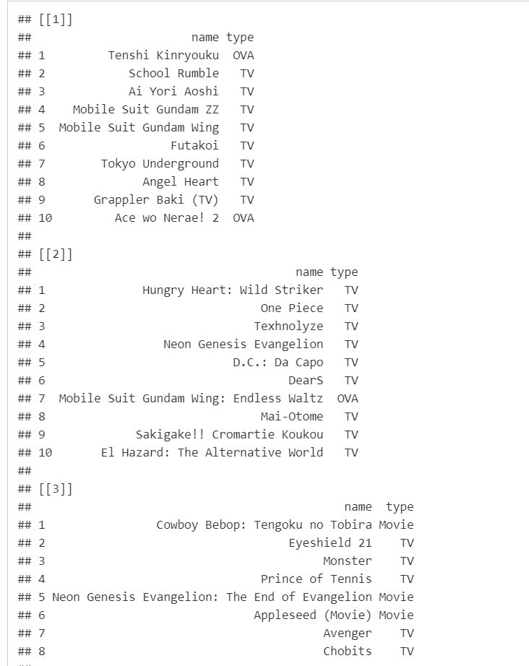
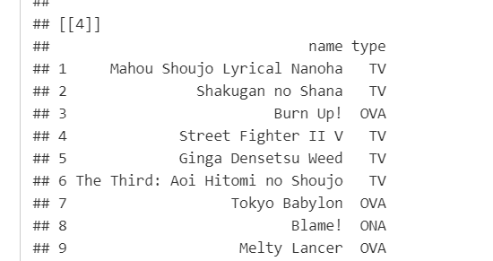
Slide 1
Slide 2
Slide 3
Slide 4
Slide 5
www.AnimeRecommendation.com

Slide 15
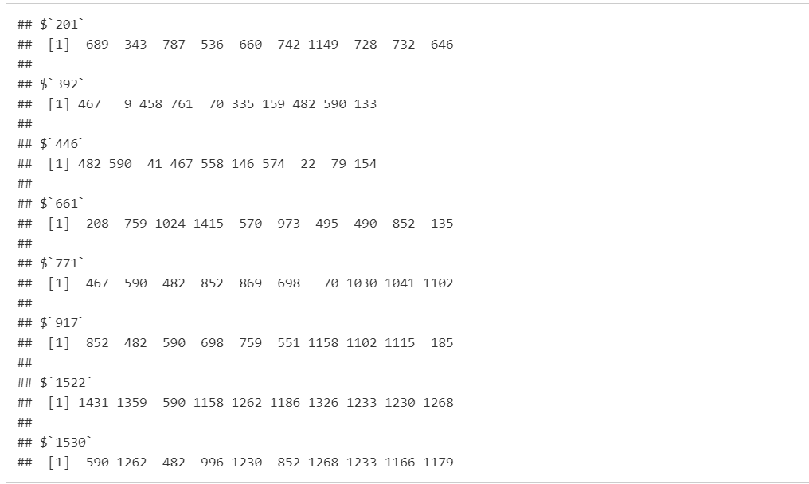
Slide 1
Slide 2
Slide 3
Slide 4
Slide 5
www.AnimeRecommendation.com
Single Value Decomposition:

Slide 16
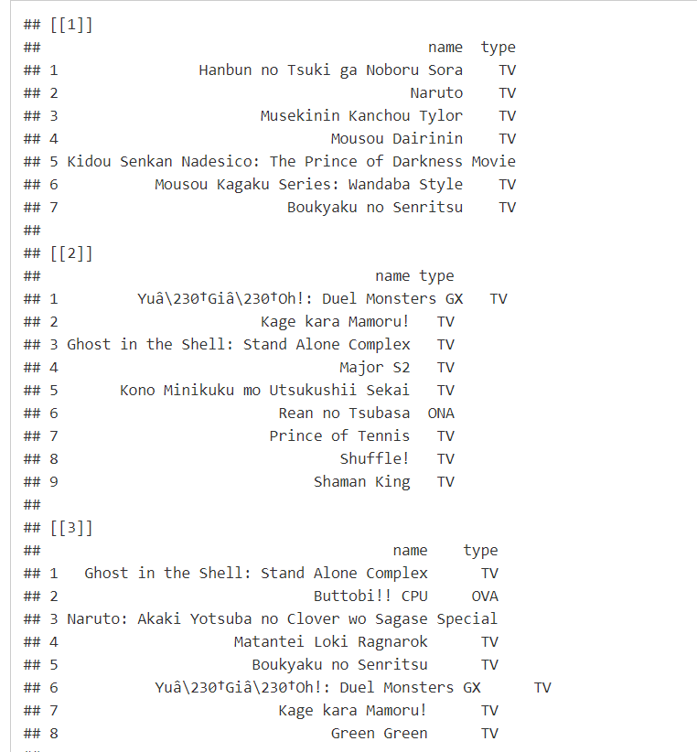
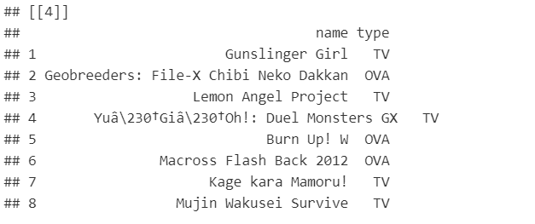
Slide 1
Slide 2
Slide 3
Slide 4
Slide 5
www.AnimeRecommendation.com

Slide 17
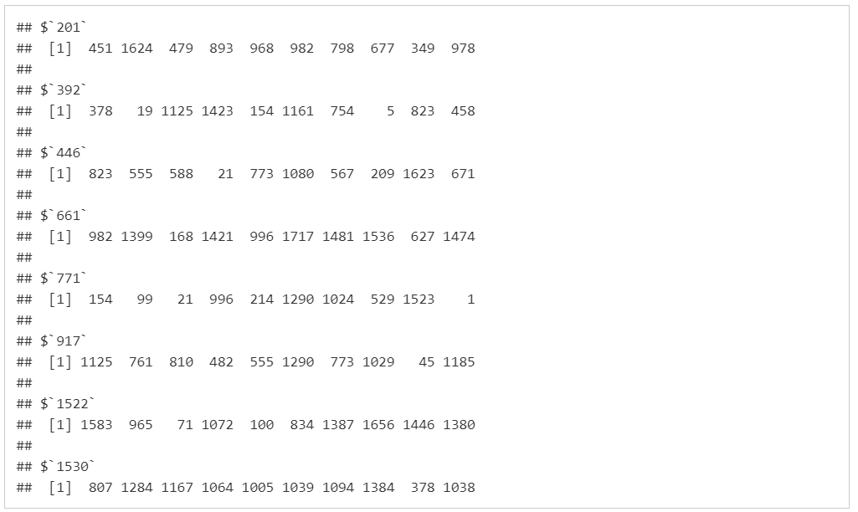
Slide 1
Slide 2
Slide 3
Slide 4
Slide 5
www.AnimeRecommendation.com
Hybrid Recommender:

Slide 18
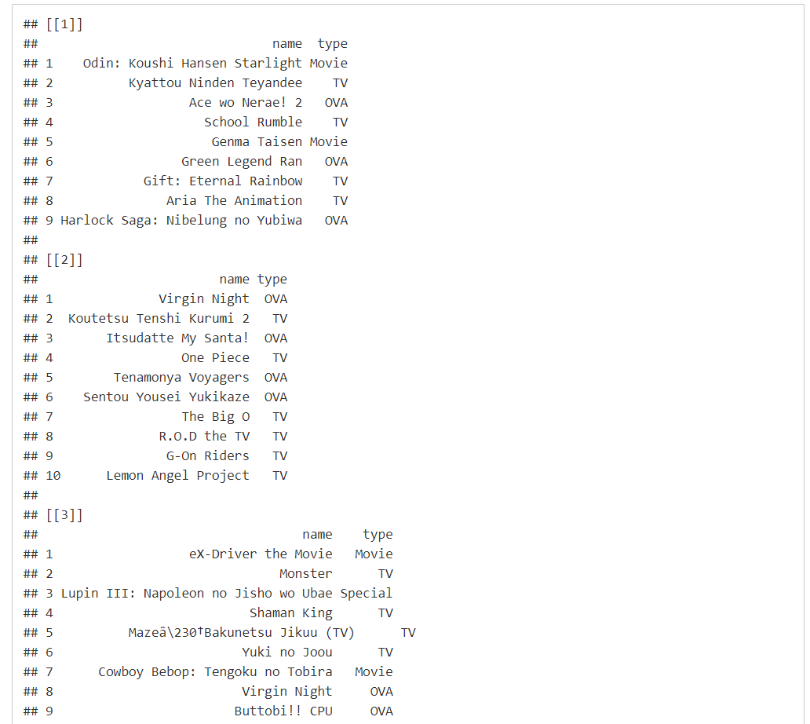
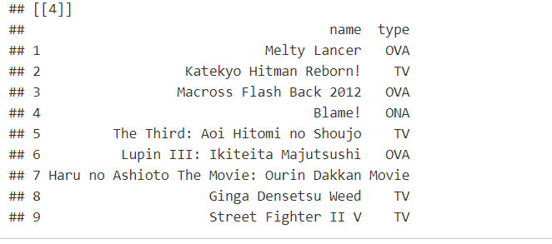
Slide 1
Slide 2
Slide 3
Slide 4
Slide 5
www.AnimeRecommendation.com

Slide 19
Slide 1
Slide 2
Slide 3
Slide 4
Slide 5
www.AnimeRecommendation.com
Conclusion:
This project discussed the three recommendation techniques and highlighted their strengths and weaknesses.
Item based recommender had the trouble of recommending items for some new users. This is a problem for collaborative filtering recommenders due to a of lack of enough information where only a few of the total number of items available in a database rated by users.
Overall, the Hybrid Recommender performed best due to it having the lowest error score.

Slide 20

Thank You
Any questions?

